Slide 1

Power Derivatives Market Update
April 2025

Slide 2
EEX Group Volumes Power Derivatives – April
Commodity | April 2025 | Volumes YTD | Volumes Previous Year YTD | Change
EEX Power Derivatives Market Europe (MWh) | 825,686,787 | 3,334,247,452 | 2,659,905,584 | 25%
German Power Futures | 576,563,874 | 2,335,422,899 | 1,896,800,417 | 23%
French Power Futures | 117,744,681 | 487,525,278 | 367,212,269 | 33%
Italian Power Futures | 64,083,129 | 253,994,558 | 191,220,448 | 33%
Hungarian Power Futures | 17,407,604 | 64,082,519 | 42,227,840 | 52%
Dutch Power Futures | 15,040,709 | 58,171,116 | 45,710,725 | 27%
Spanish Power Futures | 18,662,586 | 71,284,348 | 58,253,098 | 22%
Other CSEE Power Futures³ | 6,936,675 | 19,434,226 | 9,374,882 | 107%
Swiss Power Futures | 2,666,417 | 13,797,741 | 16,524,684 | -17%
Austrian Power Futures | 3,416,566 | 14,053,427 | 13,948,052 | 1%
Belgian Power Futures | 2,120,293 | 9,567,953 | 6,609,940 | 45%
Greek Power Futures | 1,091,805 | 5,863,520 | 2,685,535 | 118%
Nordic Power Futures² | 131,448 | 1,042,401 | 8,733,092 | -88%
GB Power Futures | 3,000 | 7,392 | 604,383 | -99%
Power Options | - | 74 | 219 | -66%
EEX Power Derivatives Market Japan (MWh) | 13,217,292 | 48,961,032 | 21,037,716 | 133%
Nodal Power Derivatives Market US (MWh) | 357,988,337 | 1,190,269,183 | 1,236,567,905 | -4%
Power Spot Market Europe (MWh)¹ | 82,872,032 | 347,434,996 | 292,971,091 | 19%
EEX Group Global Power Total (MWh) | 1,279,946,448 | 4,920,912,663 | 4,210,482,296 | 17%
Overall volume of 825.7 TWh in European Power Derivatives Market
With 18.7 TWh, Spanish Power recorded the highest monthly volume for this year
Japan Power continues to record growth of well over 100%
1 Includes EPEX SPOT, SEEPEX, PXE & BSP.
2 Sum of Nordic System Price Futures & Nordic Zonal Futures.
3 Includes EEX-PXE Czech, Polish, Slovakian, Slovenian, Serbian, Romanian, Bulgarian and Croatian Power Futures

Slide 3
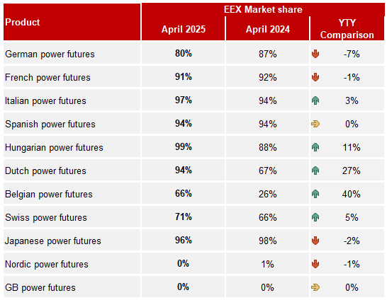
EEX Market Shares | Power Derivatives
©EEX GROUP 2025

Slide 4
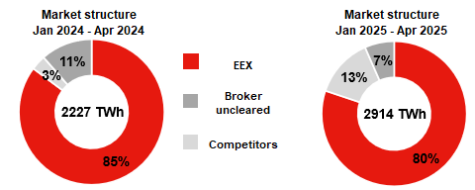
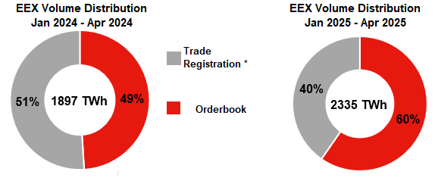
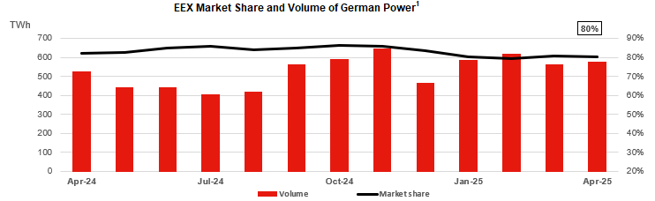
EEX German Power Futures
577 TWh +10.2%
Volumes YoY Change
2,062 TWh +8.1%
Gross OI YoY Change
¹ The calculation of EEX' market share is based on the figures published by the exchanges and the London Energy Brokers' Association (LEBA) every month. .
² Source: Thomson Reuters

Slide 5
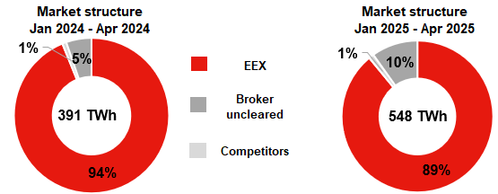
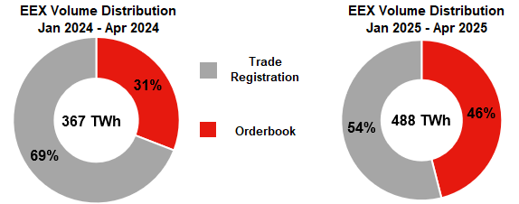
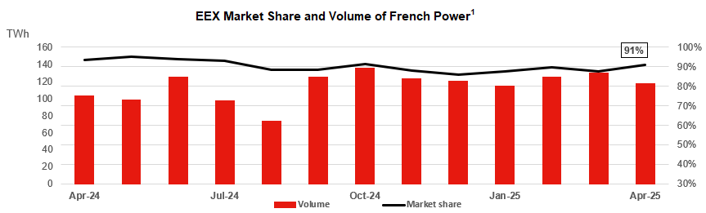
EEX French Power Futures
118 TWh +14.7%
Volumes YoY Change
499 TWh +63.88%
Gross OI YoY Change
¹ The calculation of EEX' market share is based on the figures published by the exchanges and the London Energy Brokers' Association (LEBA) every month.
² Source: Thomson Reuters

Slide 6
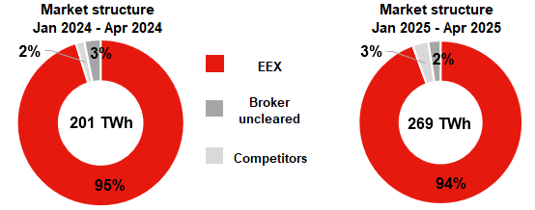
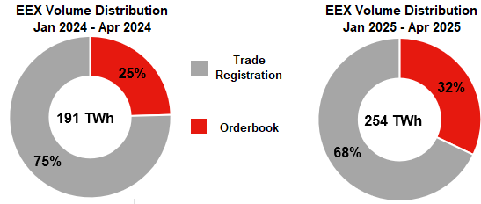
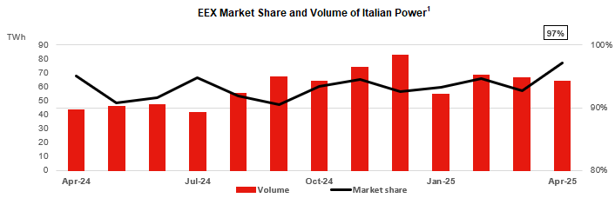
EEX Italian Power Futures
64 TWh +47.1%
Volumes YoY Change
249 TWh +28.1%
Gross OI YoY Change
¹ The calculation of EEX' market share is based on the figures published by the exchanges and London Energy Brokers' Association (LEBA) every month.
² Source: Thomson Reuters

Slide 7
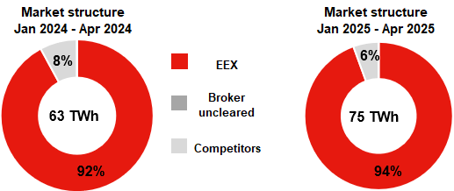
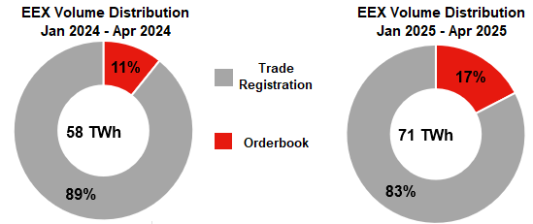
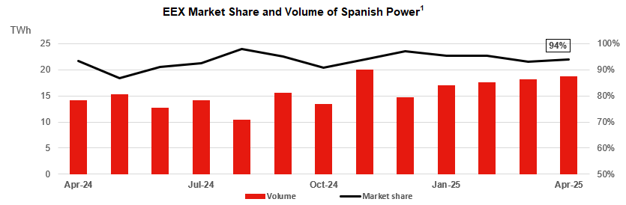
EEX Spanish Power Futures
19 TWh +32.4%
Volumes YoY Change
91 TWh +22.9%
Gross OI YoY Change
¹ The calculation of EEX' market share is based on the figures published by the exchanges and the London Energy Brokers' Association (LEBA) every month.
² Source: Thomson Reuters

Slide 8
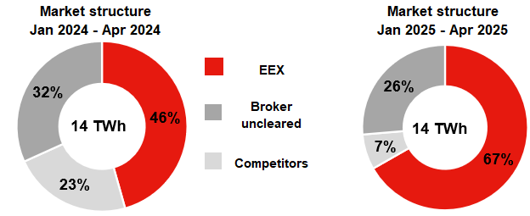
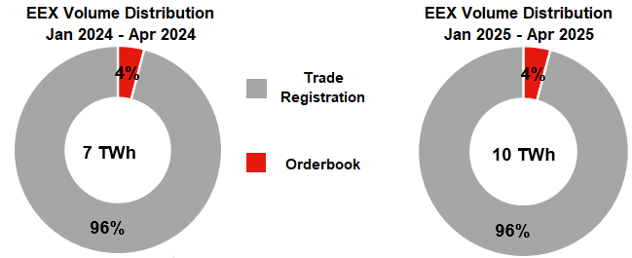
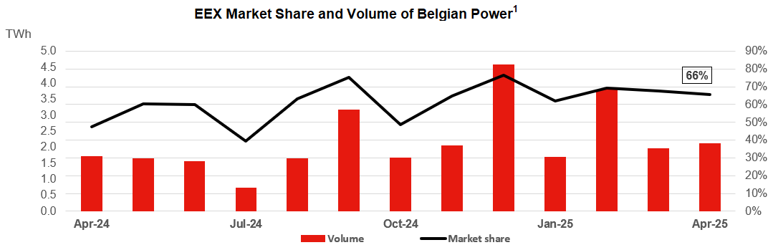
EEX Belgian Power Futures
2 TWh +24.3%
Volumes YoY Change
13 TWh +81.2%
Gross OI YoY Change
¹ The calculation of EEX' market share is based on the figures published by the exchanges and the London Energy Brokers' Association (LEBA) every month.
² Source: Thomson Reuters

Slide 9
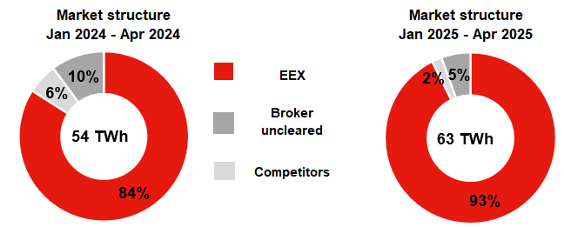
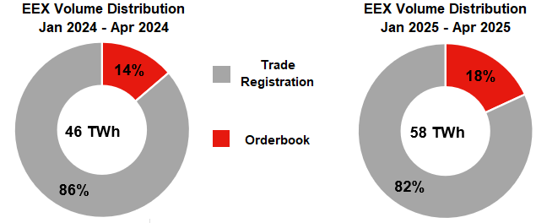
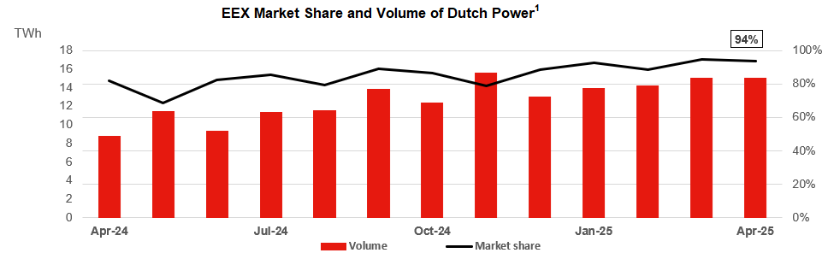
EEX Dutch Power Futures
15 TWh +71.2%
Volumes YoY Change
91 TWh +32.1%
Gross OI YoY Change
¹ The calculation of EEX' market share is based on the figures published by the exchanges and the London Energy Brokers' Association (LEBA) every month.
² Source: Thomson Reuters

Slide 10
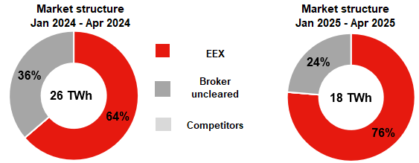
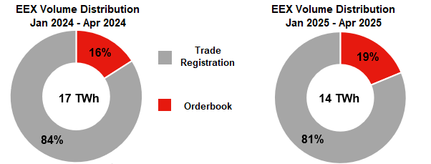
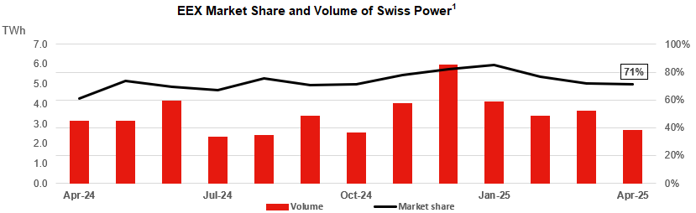
EEX Swiss Power Futures
3 TWh -14.3%
Volumes YoY Change
15 TWh +14.9%
Gross OI YoY Change
¹ The calculation of EEX' market share is based on the figures published by the exchanges and the London Energy Brokers' Association (LEBA) every month.
² Source: Thomson Reuters

Slide 11
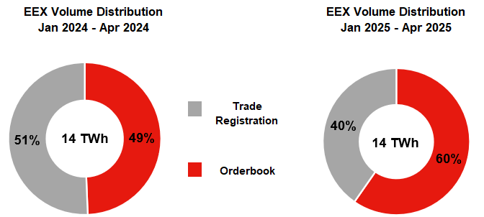
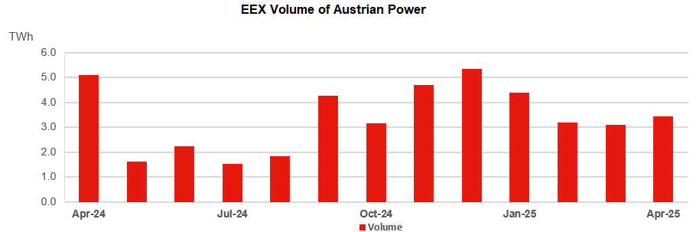
EEX Austrian Power Futures
3 TWh -32.8%
Volumes YoY Change
17 TWh -2.3%
Gross OI YoY Change
¹ The calculation of EEX' market share is based on the figures published by the exchanges and the London Energy Brokers' Association (LEBA) every month.
² Source: Thomson Reuters

Slide 12
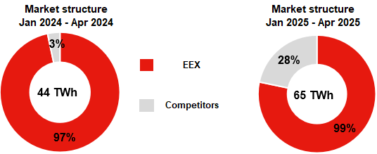
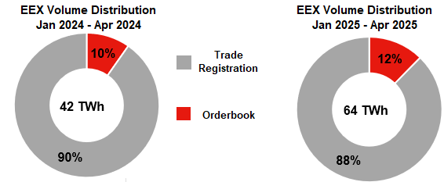
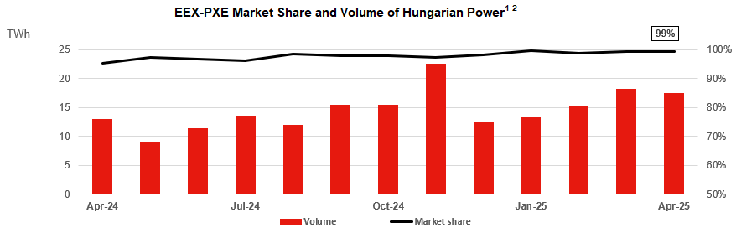
EEX Hungary Power Futures
18 TWh +34.0%
Volumes YoY Change
60 TWh +18.2%
Gross OI YoY Change
¹ The calculation of EEX' market share is based on the figures published by the exchanges and the London Energy Brokers' Association (LEBA) every month.
² Source: Thomson Reuters

Slide 13
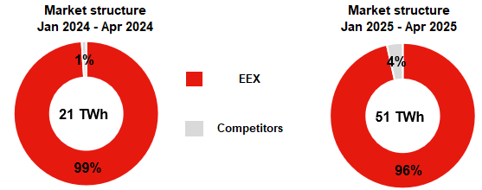
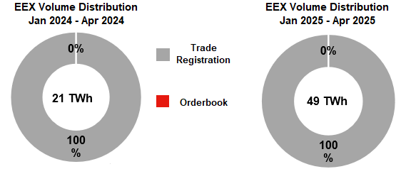
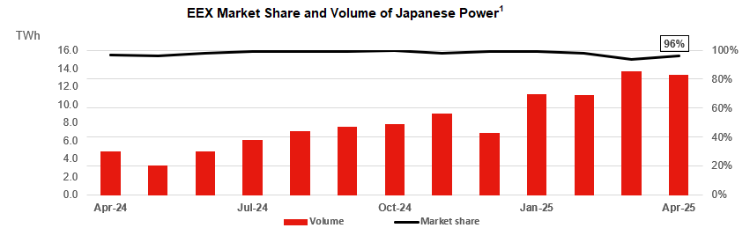
EEX Japan Power Futures
13TWh +180.3%
Volumes YoY Change
46 TWh +132.9%
Gross OI YoY Change
¹ The calculation of EEX' market share is based on the figures published by the exchanges and the London Energy Brokers' Association (LEBA) every month.
² Source: Thomson Reuters

Slide 14
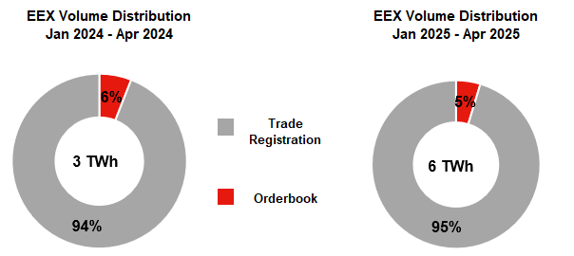
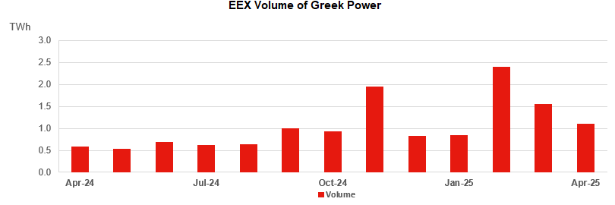
EEX Greek Power Futures
1 TWh +89.4%
Volumes YoY Change
3 TWh -37.7%
Gross OI YoY Change
¹ The calculation of EEX' market share is based on the figures published by the exchanges and the London Energy Brokers' Association (LEBA) every month.
² Source: Thomson Reuters

Slide 15
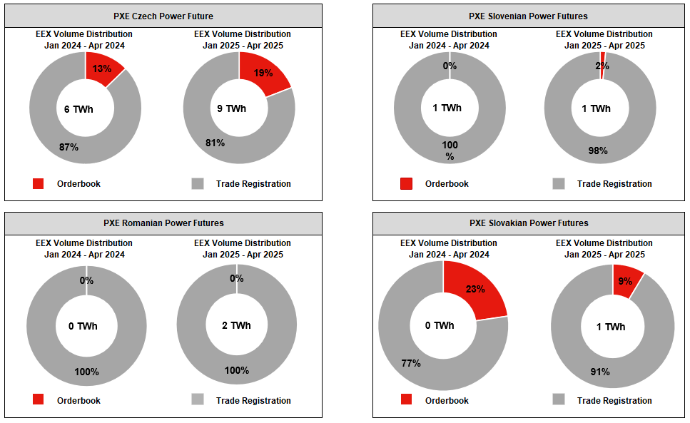
EEX Eastern-European Power Futures

Slide 16
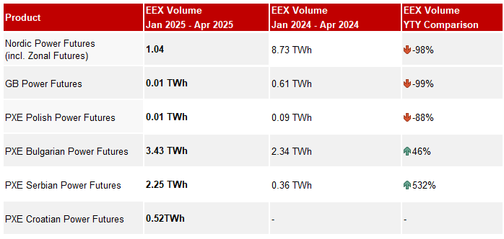
Other EEX Power Derivatives Markets

Slide 17
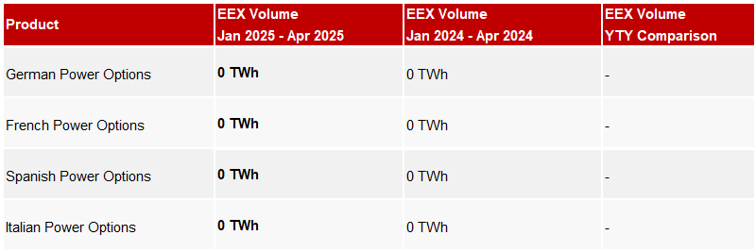
EEX Options on Power Futures

Slide 18
Thank you
Contact
Business Development
Steffen Riediger
Tel. +49 341 2156 528
@ steffen.riediger@eex.com
Sales Europe
Tim Greenwood
Tel. +49 341 2156 212
@ tim.greenwood@eex.com

