Slide 1
Guarantees of Origin Presentation
Paris
November 2020

Slide 2
EEX responsible of the GO activity in France
Role of EEX as registry and auction operator
Issuing Body in France since 2013
    Designated by the French Ministry of Energy (DG Energy and Climate) and renewed end of 2018 for 5 years
    Hold the registry for renewable GOs and CHP GOs in France (issuance, transfer, cancellation of GOs)
Member of the Association of Issuing Bodies (AIB) since 2013
    French GOs can be exported to AIB members domain and French account holders could import GO.
    EEX takes part actively in the development of the mechanism at an European level
    GOs issued by EEX meet the EECS standard
Improvement of the mechanism thank to a close collaboration with the French Ministry of Energy
    GO: the only instrument to trace electricity from renewable energies
    Implementation of the residual mix to better inform customer and avoid green attributes double counting
    More control on GOs issuance, transfer & cancellation
Mandated by the French State to organize the GO auction
    Auction of GOs issued and selected by the French State (GO from subsidized production devices)
    EEX is organizing auctions since September 2019

Slide 3
Agenda
Guarantees of Origin mechanism and registry
Guarantees of Origin auction
Guarantees of Origin fees applicable

Slide 4
GO mechanism and registry
Obligation to inform European customers
European obligation to trace power for final customer
    Obligation for suppliers to show the power mix that they provide to their final customers
      Directive 2018-2001-CE article 19 "1. For the purposes of demonstrating to final customers the share or quantity of energy from renewable sources in an energy supplier's energy mix and in the energy supplied to consumers under contracts marketed with reference to the consumption of energy from renewable sources, Member States shall ensure that the origin of energy from renewable sources can be guaranteed as such within the meaning of this Directive, in accordance with objective, transparent and non-discriminatory criteria."
Possibility provided to suppliers to propose green offers
    Need to guarantee reliability in green offers by ensuring a full transparency for final customers
Cover power consumption with GO giving information of the power production
    Final customers could choose the GO characteristics that are most important for them (technology, country, location).
    The GO system should ensure the quality and the unicity of each GO, in order to avoid double counting locally but also across Europe.

Slide 5
GO mechanism and registry
European system to trace electricity
The GO system is used to trace renewable electricity across Europe
      Directive 2018-2001-CE article 19 "2. For the purposes of demonstrating to final customers the share or quantity of energy from renewable sources in an energy supplier's energy mix and in the energy supplied to consumers under contracts marketed with reference to the consumption of energy from renewable sources, Member States shall ensure that the origin of energy from renewable sources can be guaranteed as such within the meaning of this Directive, in accordance with objective, transparent and non-discriminatory criteria."
Obligation in France to use guarantees of origin for any renewable offer
      French Energy Code – article L314-16: « […] Sur le territoire national, seules les garanties d’origine ont valeur de certification de l'origine de l'électricité produite à partir de sources renouvelables aux fins de démontrer aux clients finals la part ou la quantité d'énergie produite à partir de sources renouvelables que contient l'offre commerciale contractée auprès de leurs fournisseurs d'énergie. »

Slide 6

GO mechanism and registry
What are the characteristics of a GO?
GO Certificate
1 MWh of net injected electricity
ID number
Guarantees of Origin information
Production device information
Energy source used to produce electricity
Date &
Country of issuances
Name & Location
Type & Capacity
Start date of production
End date of
production
Start date of
the power plant
Type of subsidies

Slide 7
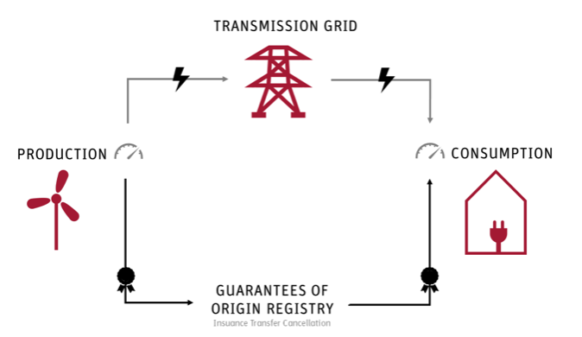
GO mechanism and registry
Lifecycle of GO
  Membership of the registry is required in order to issue or use Guarantees of Origin
Production period: month and year when electricity was produced
Issuance: Guarantees of origin creation referring to production period
Transfer: delivery process of GO from one party to another
Import – Export: GO can originate from another country
Cancellation: use of the GO certificate
  Guarantees of origin lifecycle
Production month
Expiration month of the GO
Issuance period possible
Deadline for taking into account the cancelled GOs for the calculation of the residual mix of year N

Slide 8
GO mechanism and registry
Lifecycle of GO
A GO represents a production month
A GO could be issued the 5 months following the power production
A GO expires 12 months after the power production month. A GO could be used or transferred before date of expiry.
In France, from 1st of January 2021, the period of cancellation should match with period of power production that the GO represents. For example, to cover January 2021 power consumption, company A should use a GO that has January 2021 as power production month.
From 1st of January, for helping and ensuring the residual mix calculations, it will be highly recommended to:
    Cancel all needed GO for Y-1 before 31st of March Y

Slide 9
GO mechanism and registry
A reliable system
Systematic check of registered production devices
      Document controls done by EEX
      Check by the distribution and transport service operators
      Audits in-situ organized by EEX
Systematic check of GO issuances
      Check of the power production data
      Check by the distribution and transport service operators
Surveillance of transactions
      EEX checks identity of companies that are account holders in the registry
      Surveillance of transactions
      Surveillance of imports and exports
Surveillance of cancellations
      Making controls to ensure that a GO could be transferred and used only once
      Check of volumes between green power sold and GO cancelled

Slide 10
Agenda
Guarantees of Origin mechanism and registry
Guarantees of Origin auction
Guarantees of Origin fees applicable

Slide 11
GO auction
Auction characteristics
Up to 60 products - 12 French regions and 5 technologies (solar, wind onshore, hydro, thermal, marine)
Monthly Auction
Production of M is auctioned on month M+3
A list of auctioned GOs is published before the auction
A single vendor, the French State
Multiple buyers
Pay-as-Bid Auction
+ floor price communicated to the market and defined by the French State.
Very flexible and robust tailor-made algorithm
Possibility to make different kind of orders (region, technology, production device).
Possibility to mass import order via order file
Financial transactions secured by our clearing house ECC

Slide 12
GO auction
Auction process
Auction Day -10
Auction Day -7
Auction Day -2
Auction Day -1
Auction Day
Auction Day +1
Auction Day +2
List of auctioned GOs published on the EEX Auction Platform
10:00 CET
Process begins
Submitting bids
10:00 CET
Order reception
Gate Closure
Payment & Delivery
ECC proceeds to settlement of invoices with clearing banks
EEX allocates Guarantees of Origin to members on the registry according to auction results
Transaction / transfers have to be approved by receiving party
Cash
Deposit on ECC account
Modification of Trading Limits DCP model
16:00 CET
Gate closure
OR
Cash
Deposit on Clearing Banks
Modification of Trading Limits NCM model
16:00 CET
Gate closure
ECC sends daily cash limits to EEX
Auction
12:00 CET
Publication of Results

Slide 13
GO auction
Different orders possible
Simple orders
  Specific simple orders: volume/price
  concerning a pairing of region/technology
  + expression of preference for particular devices
  will be possible
  Generic simple orders: volume/price
  concerning a whole region, a whole
  technology, or all regions and all technologies
Multiple Orders
  Combination of simple orders with different prices, but all for the same volume.

Slide 14
GO auction
2021 Calendar
Calendar available here.

Slide 15
Agenda
Guarantees of Origin mechanism and registry
Guarantees of Origin auction
Guarantees of Origin fees applicable

Slide 16
GO registry and auction
Applicable fees
Annual fees | Price in € (without taxes)
Registry Admission | 1 000 € per year
Auction Admission | 2 000 € per year
Production devices registration | 10 € per year per production device
Transaction fees | Price in € (without taxes)
Issuances | 0,01 € / MWh
Imports | 0,01 € / MWh
Transfer / Auctions fees | 0,005 € / MWh
Exports | 0,005 € / MWh
Cancellations | 0,01 € / MWh

Slide 17
If you have any question, please contact: go-support@powernext.com
Paris
November 2020

